Slide 1
CHRISTIAN UNDERSTANDING OF HUMAN SEXUALITY IN THE LIGHT OF THE SPREAD OF LGBTQI…
BY LAWYER MOSES FOH-AMOANING

Slide 2
SCOPE OF HOMOSEXUALITY
HISTORICAL ANTECEDENT OF HOMOSEXUALITY
SCIENTIFIC DIMENSION
PSYCHIATRIC UNDERPINNINGS OF LGBTQI…
LEGAL PERSPECTIVE
DISTINCTION BETWEEN THE EURO-CENTRIC VIEW AND AFRO-CENTRIC VIEW
THE APPROACH OF THE CHURCH
SUGGESTIONS AND WAY FORWARD
OUTLINE

Slide 3
SCOPE OF HOMOSEXUALITY
Homosexuality is the sexual attraction to a person of same sex
Homosexuality IS NOT THE SAME AS sex with same-sex person
However, sexual attraction of any kind may lead to sex, but not necessarily
Thus if a heterosexual couple, desiring to be adventurous for spice of love, have anal sex, that is not homosexuality. It is kinky sex.

Slide 4
DEFINATION
  Sexual orientation in which emotional and sexual attraction are directed toward members of the same sex (Strong, DeVault, Sayad, & Yarber, 2002).
  People’s sexual feelings that are predominantly directed toward persons of the same sex as themselves (LeVay & Valente, 2003).

Slide 5
HISTORICAL ANTECEDENT OF HOMO…
Homosexuality was considered psychological disorder all along
In 1952 American Psychiatric Association (APA) codified all psychiatric disorders in the first edition of DSM (Diagnostic and Statistical Manual of Psychiatric Disorders) and coded homosexuality as a disorder.
Political pressure by gay society got the position changed in a poll
The change in the position was not based on science

Slide 6
ORIGINS
  1. BIOLOGICAL
  Genetic
  Hormonal
  Anatomical
Inborn/Enduring
Uncontrollable
Sexual Orientation
No compelling evidence for a distinctly genetic basis (McGuire, 1995; Nuffield Council on Bioethics, 2001).
Hormonal imbalance (male testosterone and female oestrogens)
Homosexuals have bigger right brains with bigger sex nuclei than straight people
Twin studies show high concordance rate among identical twins, so possibly gay genes

Slide 7
  PSYCHO-SOCIAL
  Individual Choice
  Decision making
  Identity development
  Conformity
Environmental/Learned
Controllable
Sexual Preference
No single account has won the favor of the scientific community (Sheldon et al., 2007).

Slide 8
NOTE
Human Genome Project (HGP) found no gay gene
HGP began in 1984, completed in 2003, reported in 2004
22,300 genes isolated for human behaviours
Not a single gene was found responsible
Efforts still ongoing to identify gay gene and more proof of biological basis

Slide 9
PSYCHIATRIC DIMENSION
THE QUESTION?
Is homosexuality a psychological/psychiatrical disorder?
BY DEFINATION…… YES, BECAUSE…
Departure from the norm (ie. an abnormality)
Severe and persistent abnormality
Causes pain or distress to the person or to the society
Associated with other abnormalities
Comparable to paedophilia, necrophilia, bestiality, fetishim, voyeurism and froteurism, all psychological disorders

Slide 10
LEGAL DIMENSION: Human rights versus people’s rights on homosexuality
Pan-American Charter of Human Rights
European Charter of Human Rights
Asian Charter of Human Rights
Arab Charter of Human Rights
But ‘African Charter of Human and People’s Rights’, taking into consideration the African’s communalistic nature in which the society matters more than, or as much as, the individual
Human Rights Court of Strasbourg, France, declaring that gay right to marry is not human rights.

Slide 11
BIBLICAL BASIS
“If a man lies with a male as with a woman, both of them have committed an abomination; they shall surely be put to death; their blood is upon them.” Leviticus 20:13
“You shall not lie with a male as with a woman; it is an abomination.” Leviticus 18:22
Romans 1:26-28
²⁶ That is why God abandoned them to their shameful desires. Even the women turned against the natural way to have sex and instead indulged in sex with each other.
²⁷ And the men, instead of having normal sexual relations with women, burned with lust for each other. Men did shameful things with other men, and as a result of this sin, they suffered within themselves the penalty they deserved.
²⁸ Since they thought it foolish to acknowledge God, he abandoned them to their foolish thinking and let them do things that should never be done.

Slide 12

STRATEGIES OF THE CHURCH
EDUCATION, EDUCATION, EDUCATION!!

Slide 13
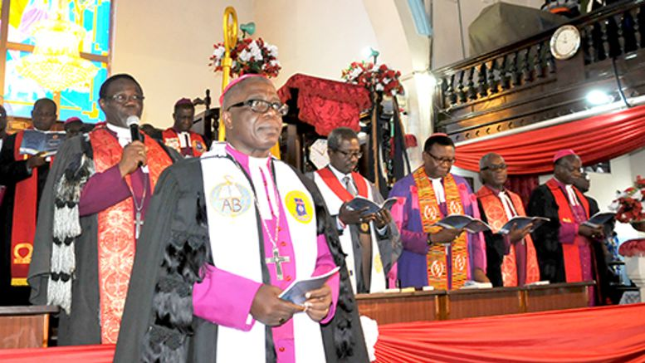
PREACH IT!!! PREACH IT!!!

Slide 14

DELIVERANCE

Slide 15
MILLITANCY

Slide 16
WAY FORWARD
Create awareness on homosexuality as abnormal
Speak out against the creeping acceptance by society and the danger of it being foisted on us
Homosexuality is an abnormality and a psychological/mental disorder
Biological basis no proof of normality but proof of abnormality requiring treatment
Physical complications to be immediately treated
Psychological basis can be helped through CBT
Biological basis can be helped medically through hormone replacement therapy
We need concerted effort to handle the near epidemic

Slide 17
FINALLY
If homosexuality offends the sensibility of the African culture, that cannot be encouraged in the name of human rights
It should be countered with People’s Rights Charter

Slide 18
COME ON BOARD AND LET US STAND AGAINST THIS ONSLAUGHT!!
GOD IS COUNTING ON GHANA AND IT STARTS WITH YOU !!!!!!!!!

Slide 19

THANK YOU

