Slide 1
PRACTICAL SOLUTIONS FOR FAMILY SUSTAINABILITY

Slide 2
A father is implored to bring their children up in the ways of the Lord, to discipline them and to encourage, comfort and instruct them.

Slide 3
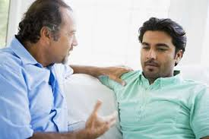
Fathers Give Direction And Discipline To Their Children

Slide 4

Ephesians 6:4 Fathers, do not provoke your children to anger, but bring them up in the discipline and instruction of the Lord.

Slide 5
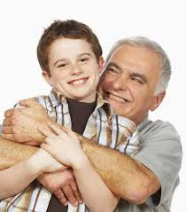
⁵ Behold, I will send you Elijah the prophet before the coming of the great and dreadful day of the Lord:
⁶ And he shall turn the heart of the fathers to the children, and the heart of the children to their fathers, lest I come and smite the earth with a curse.

Slide 6
WHY THE TURN?
Turn the heart of the fathers to the children

Slide 7
THE EFFECT OF THE TURN
And that we may be delivered from unreasonable and wicked men: for all men have not faith

Slide 8
THE PATHWAY
Family Renaissance and The National Coalition For proper Sexual Rights And Family Values, which we want to replicate in all African countries, we will engage the family by doing the following

Slide 9
0 – SIX MONTHS MEDIA ENGAGEMENT
To have the fathers admit that they have failed the children, this is to bring about healing.

Slide 10

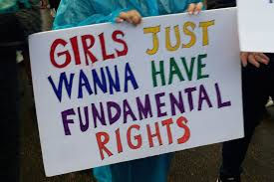
MOTHERS
We the mothers also will apologize for pursuing feminism thereby turning away from “mothering” which was our initial call and pursued feminism hence we murdered the generation that we were supposed to “mothered”.

Slide 11
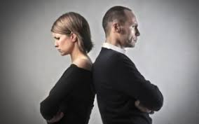
The fathers will have to take responsibility for the home. Every family must have a culture because culture is what informs the mind.

Slide 12
ADVOCACY 1-2 YEARS
Formation of boys and girls club
Giving support to the content of the school curriculum
Engagement with Traditional rulers
Religious bodies

Slide 13
YEAR 3 -5
Renaissance School
Building Capacity
Raising Leaders

Slide 14
conclusion
Its not enough to talk but we must walk the talk.

Slide 15
It seemed as if darkness have overcome light,

Slide 16
lies have overtaken the truth,

Slide 17
good has bowed at the gate of evil,

Slide 18
death has swallowed up life,

Slide 19
injustice walk freely on the street of peace and equity,

Slide 20

…but in all these we are more than conquerors.

Slide 21
ISA 58:12
YOUR PEOPLE WILL REBUILD THE ANCIENT RUINS AND WILL RAISE UP THE AGE-OLD FOUNDATIONS; YOU WILL BE CALLED REPAIRER OF BROKEN WALLS, RESTORER OF STREETS WITH DWELLINGS.

