Slide 1
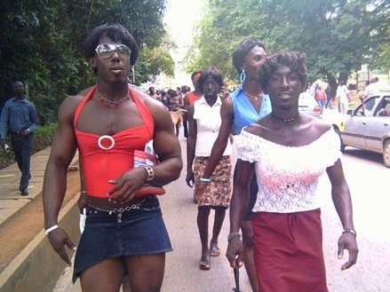
LGBTQI: THE CAUSE, CONSEQUENCE
& CURE

Slide 2
“If a man lies with a male as with a woman, both of them have committed an abomination; they shall surely be put to death; their blood is upon them.”
Leviticus 20:13
“You shall not lie with a male as with a woman; it is an abomination.”
Leviticus 18:22

Slide 3
Romans 1:26-28
²⁶ That is why God abandoned them to their shameful desires. Even the women turned against the natural way to have sex and instead indulged in sex with each other.
²⁷ And the men, instead of having normal sexual relations with women, burned with lust for each other. Men did shameful things with other men, and as a result of this sin, they suffered within themselves the penalty they deserved.
²⁸ Since they thought it foolish to acknowledge God, he abandoned them to their foolish thinking and let them do things that should never be done.

Slide 4

I. THE CAUSES

Slide 5
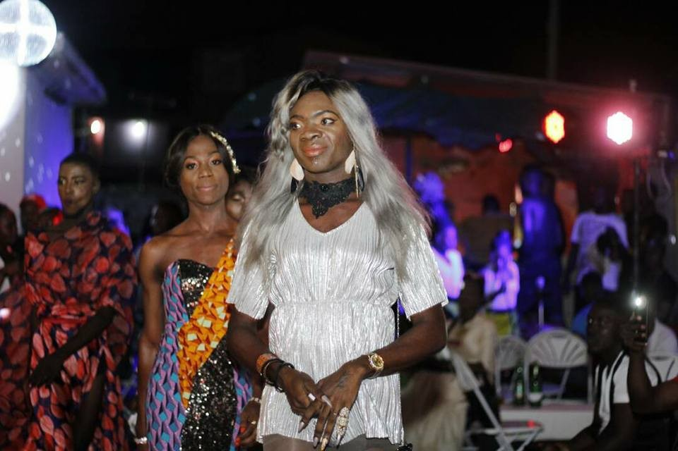
GENETICS

Slide 6
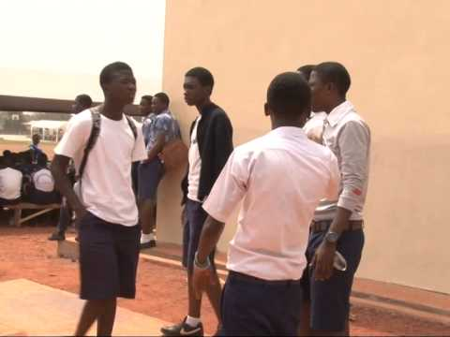
EDUCATION

Slide 7
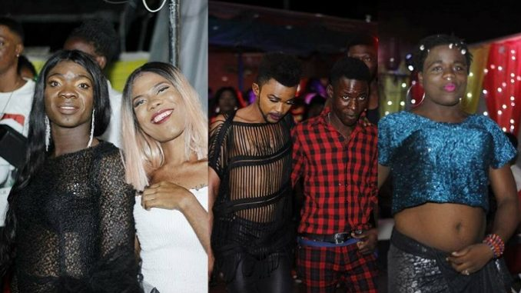
URBANIZATION

Slide 8

FAMILY ORIENTATION/EXPECTATION

Slide 9
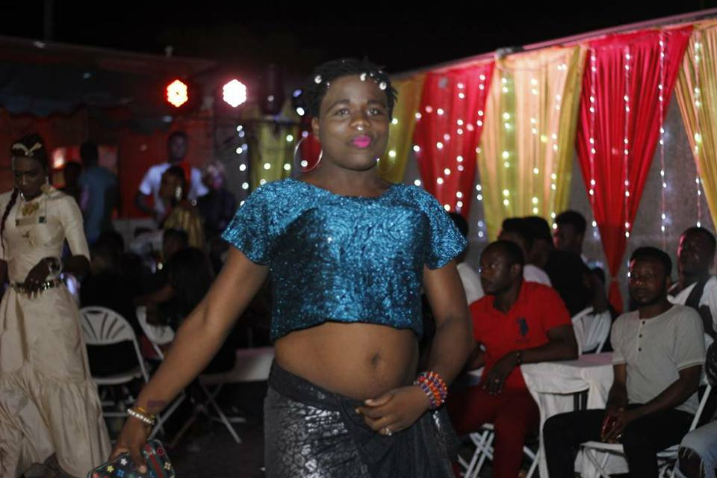
DEMONIC ATTACK

Slide 10
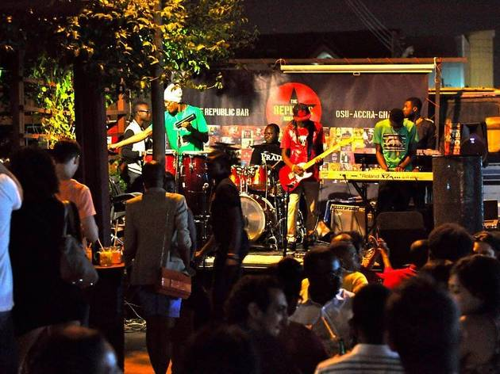
PEER PRESURE

Slide 11
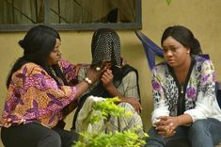
POVERTY

Slide 12
I. THE CONSEQUENCES

Slide 13
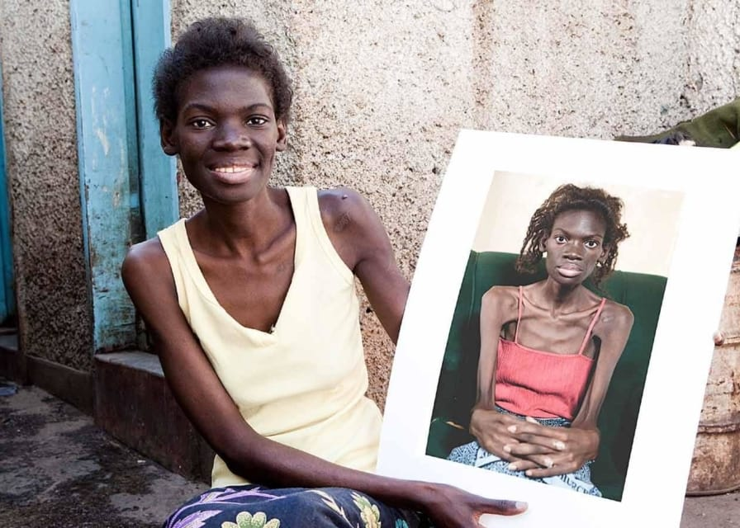

SEXUALY TRANSMITTED
DISEASES

Slide 14

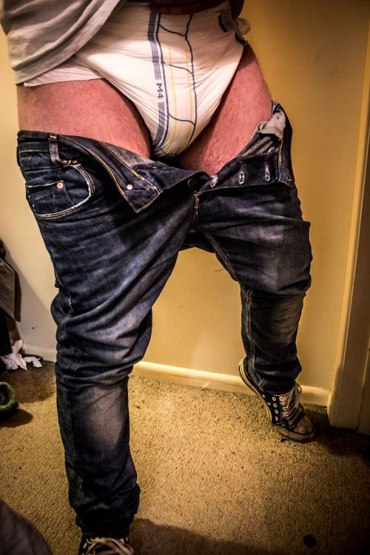
“ANAL SEXUAL MUTILATION

Slide 15
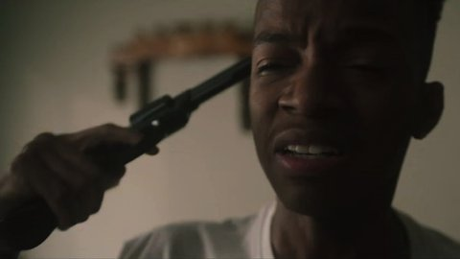
SUICIDAL

Slide 16

MARITAL PROBLEMS

Slide 17
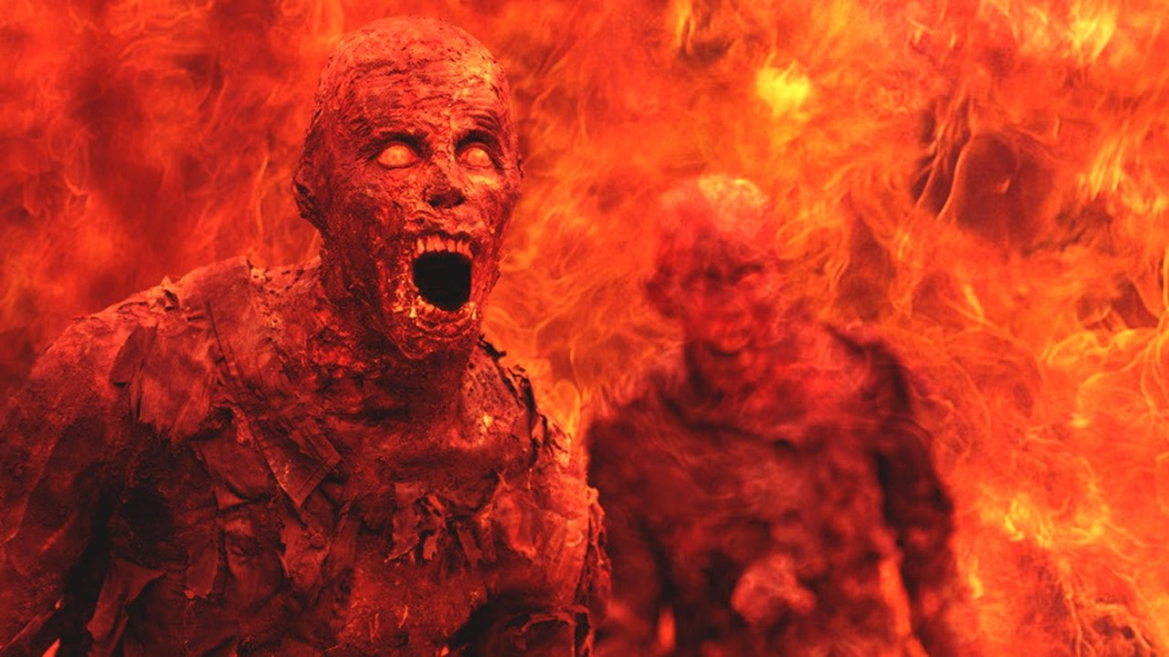
HELL FIRE

Slide 18
1 Corinthians 6:9-11
“Or do you not know that the unrighteous will not inherit the kingdom of God? Do not be deceived: neither the sexually immoral, nor idolaters, nor adulterers, nor men who practice homosexuality, nor thieves, nor the greedy, nor drunkards, nor revilers, nor swindlers will inherit the kingdom of God.
And such were some of you. But you were washed, you were sanctified, you were justified in the name of the Lord Jesus Christ and by the Spirit of our God.”

Slide 19
I. THE CURE

Slide 20

EDUCATION, EDUCATION, EDUCATION!!

Slide 22
Why its Difficult
Most of us would rather avoid controversy.
Many of us have never dealt with our own issues around sexuality.
FEAR of how youth/their parents will respond.
Lack of Biblical background.
Concern about doing something wrong.

Slide 23
Addressing the Topic
Know and share why it is important for your congregation to deal with the topic.
  General statistics
Understand and communicate the relevance to the needs of young people in your particular congregation/community.
  Local statistics/stories
Understand and communicate the UMC’s stance on the topic.

Slide 24
SEVEN IMPORTANT TOPICS FOR
SCHOOL KIDS
1. Sex Messaging – responding to cultural message teens are wading through

Slide 25
2. Sexual Identity – Helping kids think about the forces that share their sexuality.
3. Intimacy – Helping kids think about dating & non-sexual closeness.
4. Desire – Helping kids understand their appetites and needs.

Slide 26
5. Boundaries – helping kids decide what to do with their sexuality.
6. Responsibility – helping kids take sexual responsibility.
7. Do-Overs – Helping kids experience mercy, repentance, forgiveness, and restoration.

Slide 27
Develop a Plan
Decide on a resource/resources. Involve others.
Use your school’s decision-making process. Avoid surprising people.
Recruit leadership carefully/prayerfully.
Provide training.
Communicate with the whole students.
Develop a support system.
Meet with parents.
Use material appropriately.

Slide 28
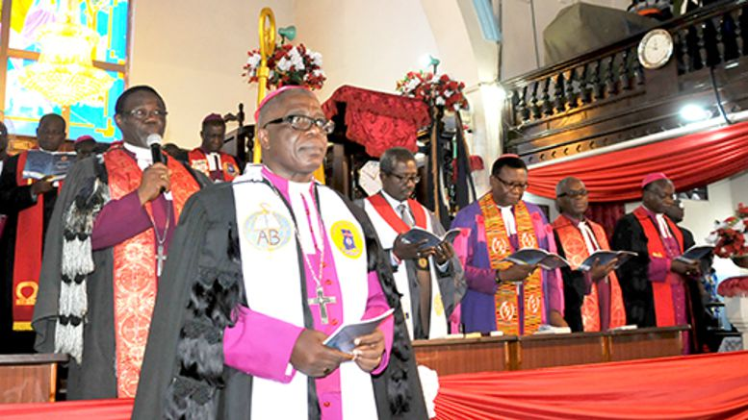
PREACH IT PREACHER!!

Slide 29

PARENTAL ROLE

Slide 30
WHY PARENTS ROLE?
Parents are primary sexuality educator from birth
Parents are most influential
Working in partnership with the church

Slide 31
Focus is theological:
  Our sexuality is part of God’s good creation as we are - created in God’s image – for relationship within the wider community.
Focus is biblical:
  Connecting the children’s
  to the God’s story in relationship with humankind.
Focus is educational:
  Involves young people in specific learning activities for the purpose of understanding the physical, social, and emotional aspects of sexuality within a spiritual framework.

Slide 32

Deliverance

