Slide 1

Politics & Policies for and against
Africa’s Sustainable Development
SESSION 5 – POLICY DRIVES FOR
SUSTAINABLE DEVELOPMENT

Slide 2
Politics & Public Policy – why are these not sustainable?
Because of the current political system – A party elder will override a policy analyst
He will use his mind versus social science
When I first met KA, over drinks he asked what I was doing in Europe. I said public policy education. His response is he had been trying to get EU to do that for years
USA is working because they have the first public policy schools and everything R&D

Slide 3
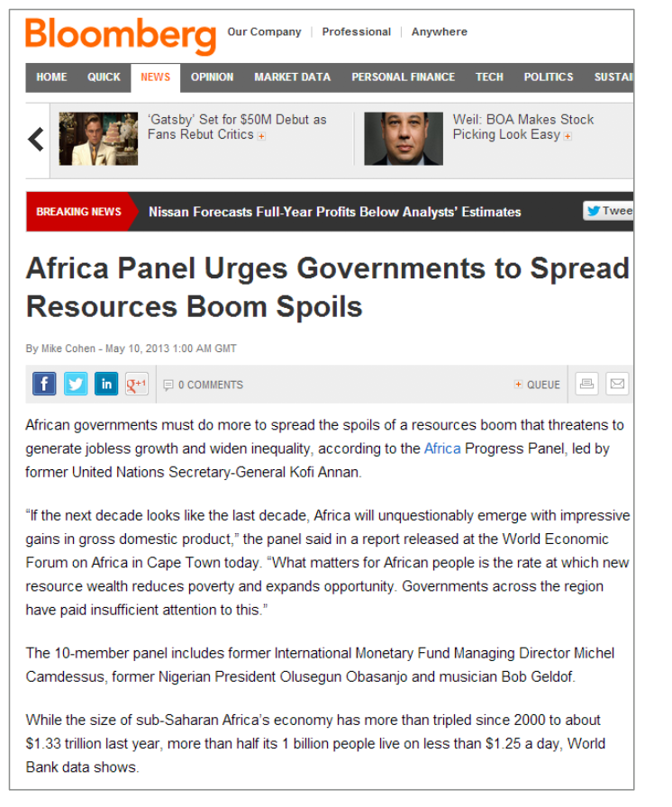
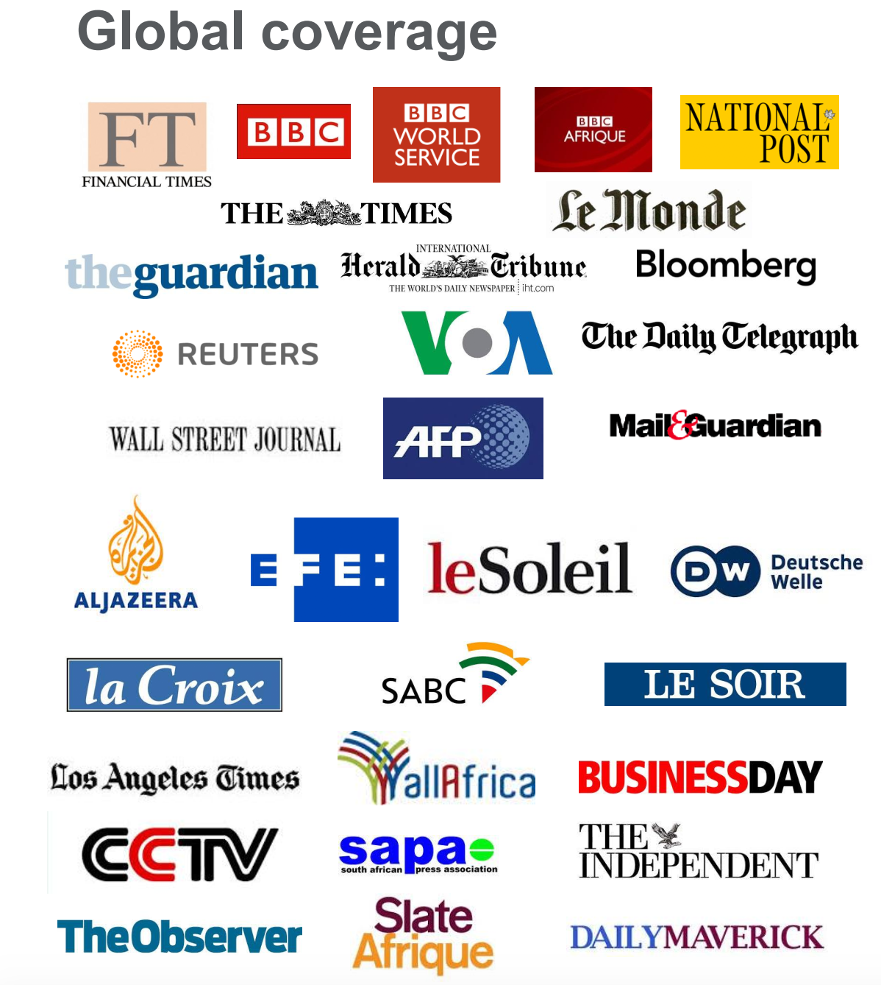

Slide 4
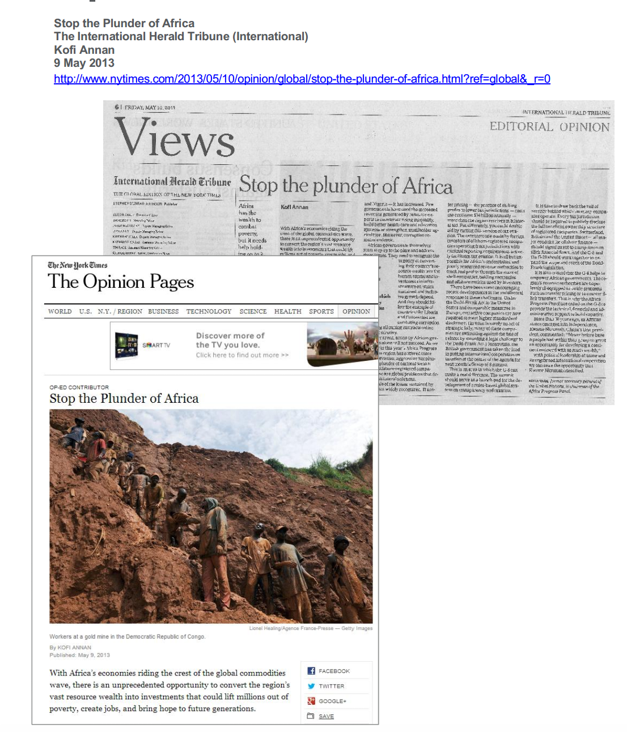
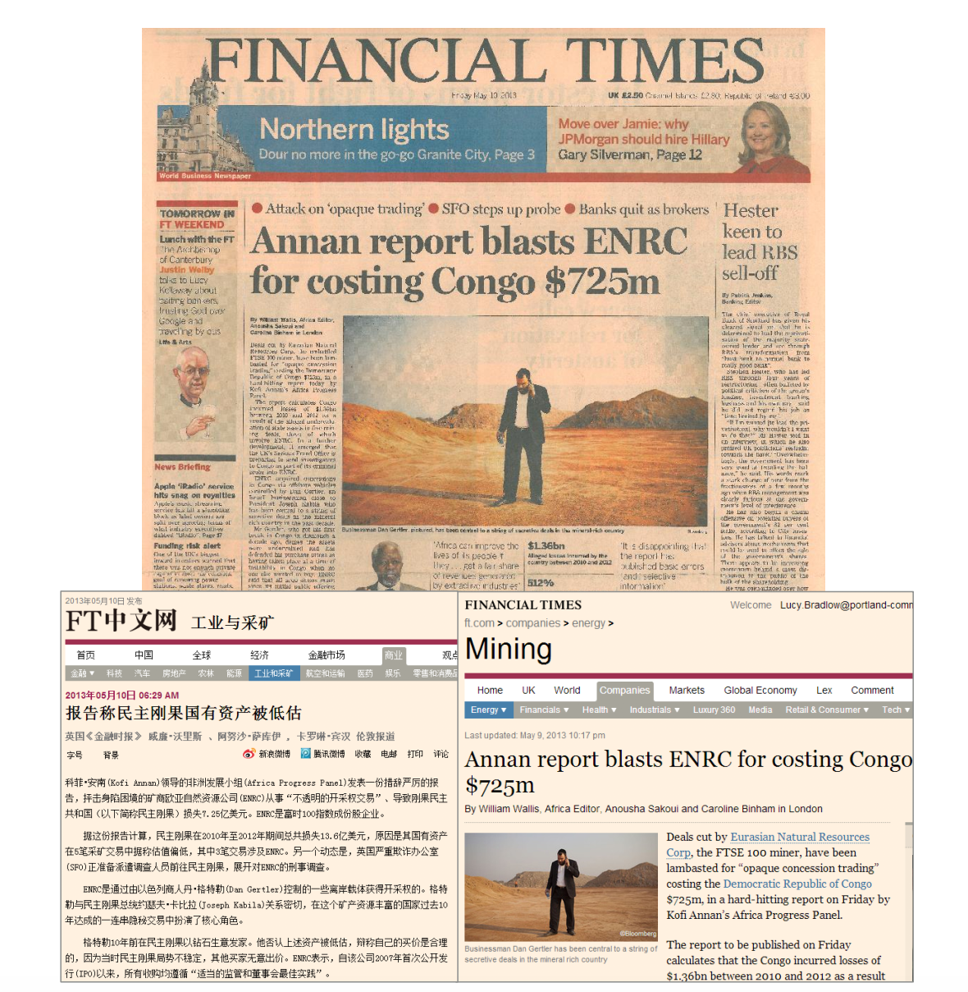

Slide 5
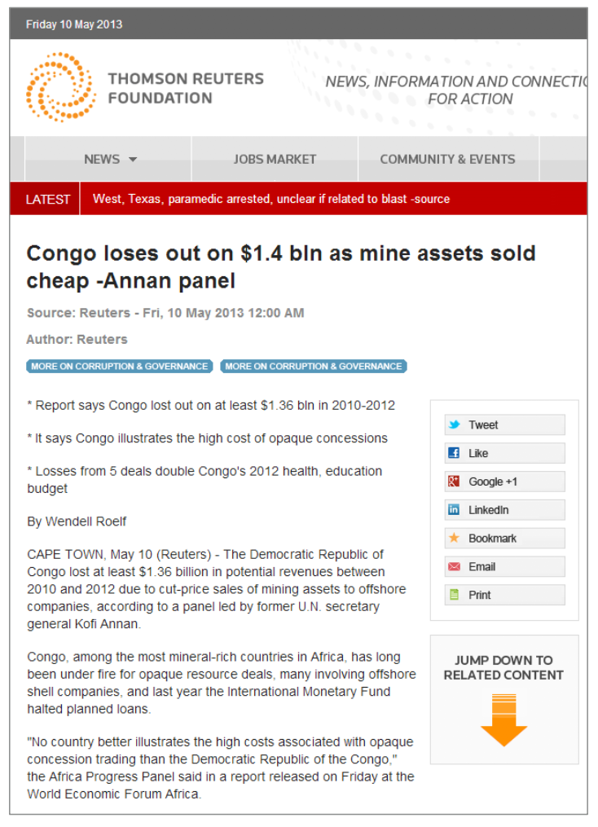
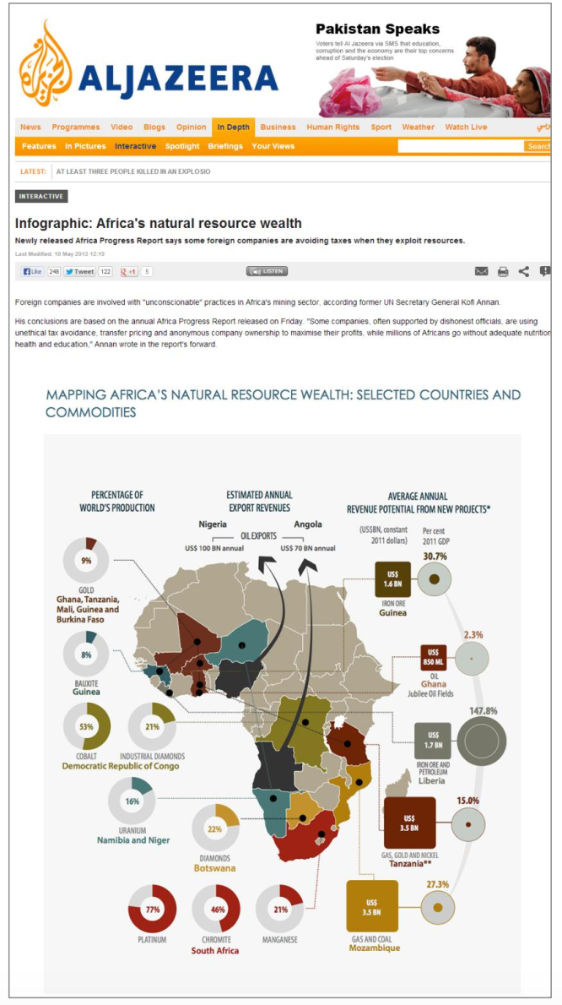

Slide 6
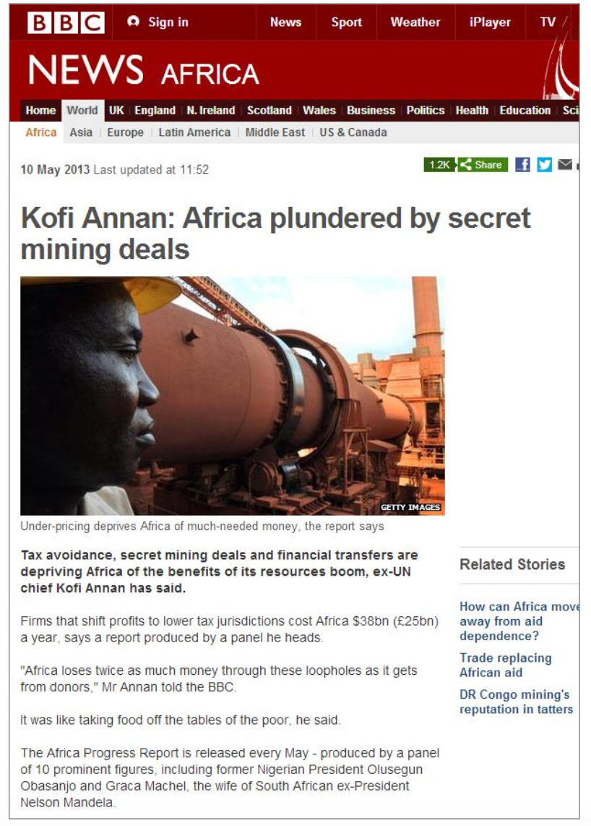
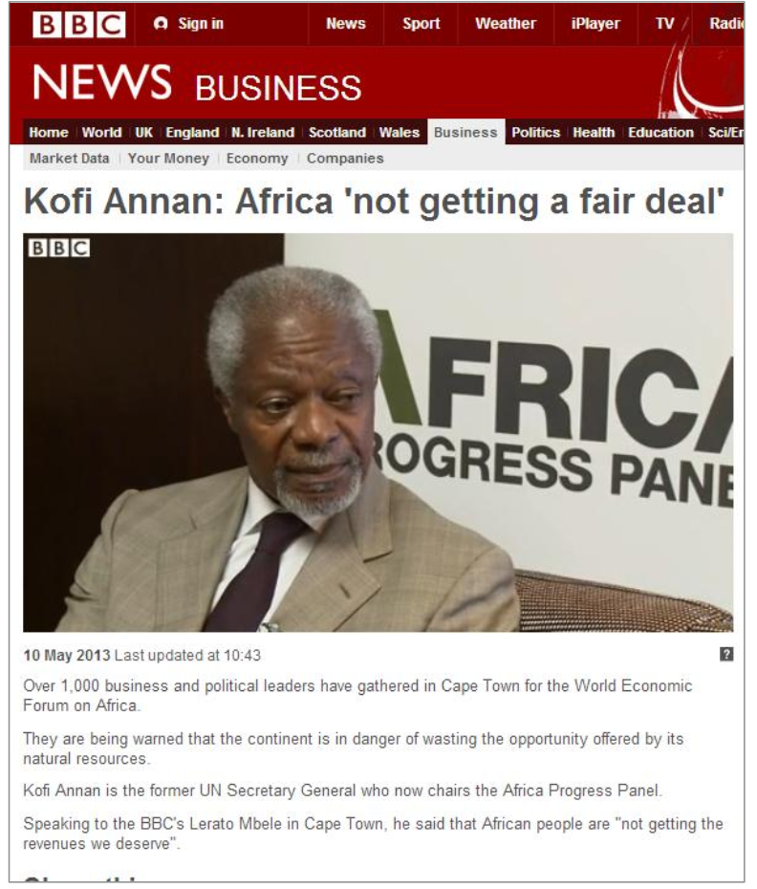

Slide 7
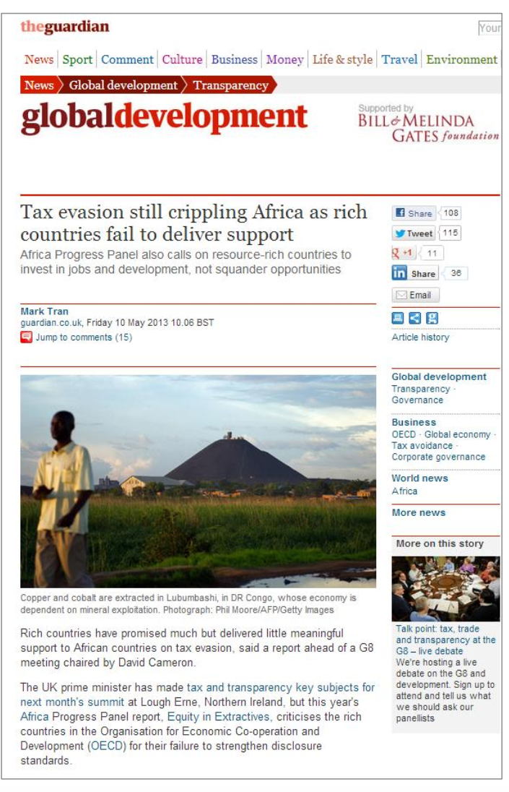
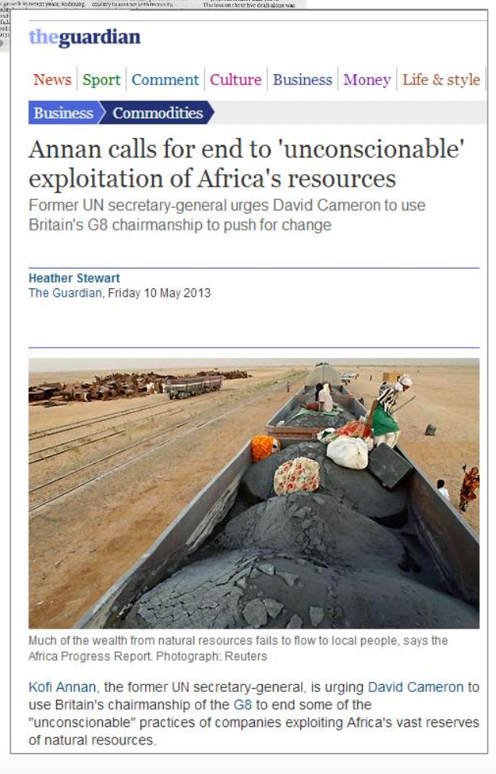

Slide 8
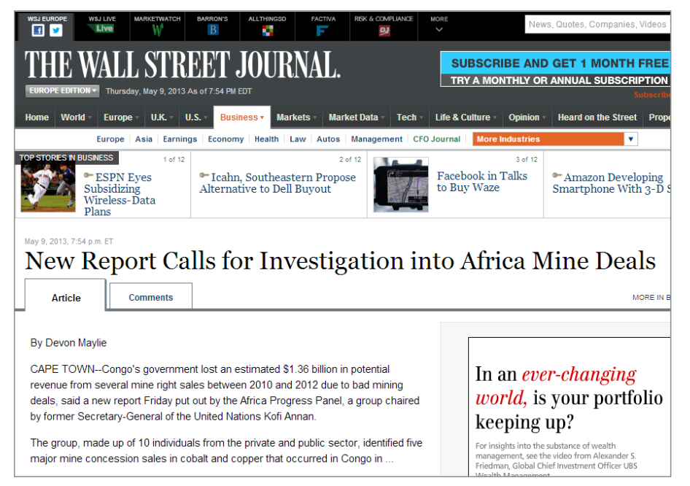
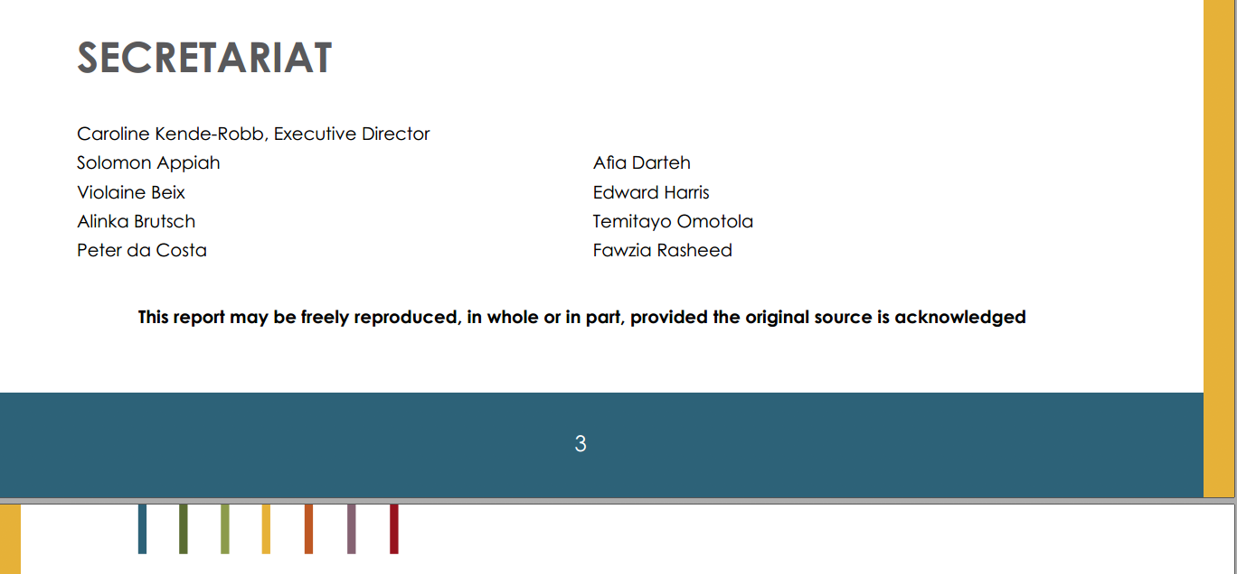
AFRICA PROGRESS REPORT 2013

Slide 9

POLITICS

Slide 10
THINGS FORGOTTEN BY LEADERS & ELECTORATE
“The Sovereignty of Ghana resides in the people of Ghana in whose name and for whose welfare the powers of government are to be exercised in the manner and within the limits laid down in this Constitution."
The powers of government enjoyed by any government administration is derived from the people, and they are to act to "secure for ourselves and posterity the blessings of liberty, equality of opportunity and prosperity."
Their job includes "the protection and preservation of Fundamental Human Rights and Freedoms, Unity and Stability for our Nation”.

Slide 11
Politic comes from the L. word politicus and is defined by 1828 Webster’s dictionary as:
Wise; prudent and sagacious in devising and pursuing measures adapted to promote the public welfare; applied to persons; as a politic prince.
Well devised and adapted to the public prosperity; applied to things.
ANY STEERING that does not lead to the prosperity or sustainable development of the populace is NOT Politics but politicasting

Slide 12
Timorous, trimming politicasters, ALL for THE PARTY without thought of THE STATE —New York Times.
“The politicaster is looking for small opportunities — for such pickings and stealings as a careless public may leave for those of his kind. The great politician is looking for great opportunities.” – Samuel McChord Crothers; In Praise of Politicians; The Wall Street Journal (New York); Jan 5, 2004.

Slide 13
PUBLIC POLICY

Slide 14
Public policy are the tools that politicians use to to promote the public welfare, public good and public prosperity
The term public policy always refers to the actions of government and the intentions that determine those actions (Clarke E. Cochran, et al.)
Public policy is the outcome of the struggle in government over who gets what (Clarke E. Cochran, et al.).
Whatever governments choose to do or not to do (Thomas Dye).

Slide 15
Public Policy is the principled guide that determines the courses of action or inaction geared towards the common good of a territory through the application of all the resources harnessed in the territory (Abu Bako, 2017).

Slide 16
Politics & Policies for and against Africa’s Sustainable Development
2019 THEME WCF AFRICAN REGIONAL CONFERENCE:
‘The African family and sustainable development: Strong families, strong nation’

Slide 17
POLICIES THAT HAVE NOT LED TO SUST. DEVT. AFRICA
Economic Policies
  Structural Adjustment Programs (SAPs)
  Economic Recovery Programs (ERPs)
Educational Policies (Curricula / CSE / SSCE v Old System)
Reproductive Health – Condoms
Media Policies – Media Content does not lead to Devt
Opaque policy making processes (GITMO2, GH – US Military Co-op as well as petroleum / Lithium deals)

Slide 18
Econ Policies: Mass Privatization
  Instead of instilling discipline we sold off national assets and are fraught with same poor services
  Fiscal discipline is not same as making economy difficult
  Adapt policies to local context
Reproductive Health (HIV) – Uganda got the answer: Abstinence not CSE and contraception
  Instill discipline, don’t condone and expect people to discipline themselves
Education and Media (content wise) properly targeted can solve unemployment, under-employability; entrepreneurial
  Bring together educators, industry, parents,

Slide 19
PRISON POLICY
Ten-Year Strategic Development Plan of the Ghana Prisons Service:
Budget allocation
Staff Strength Special Rapporteur - Kumasi for instance, the officer-inmate ratio is 1:20
Infrastructure
Nutrition GHS 1:8
Overcrowding

Slide 20
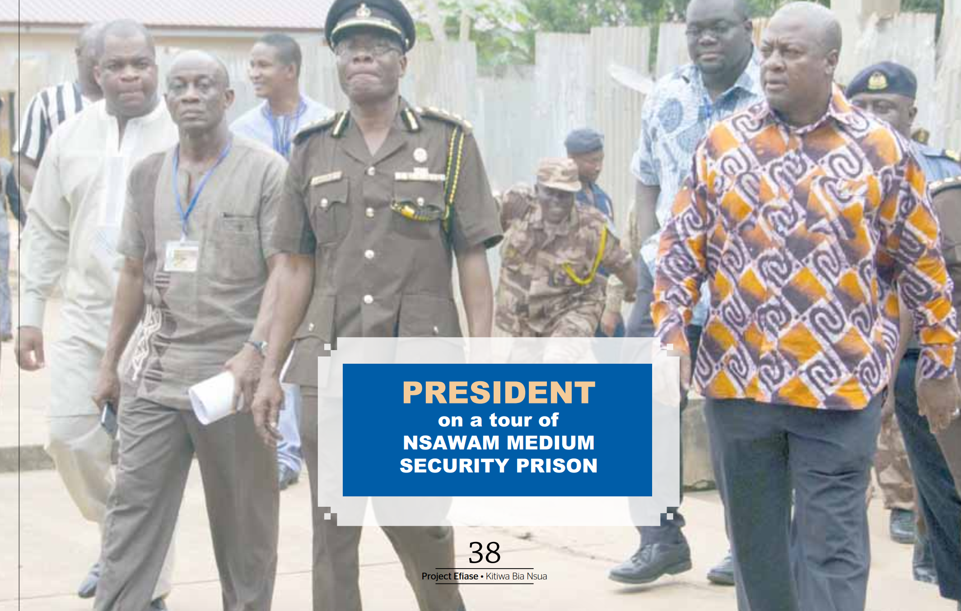

Slide 21
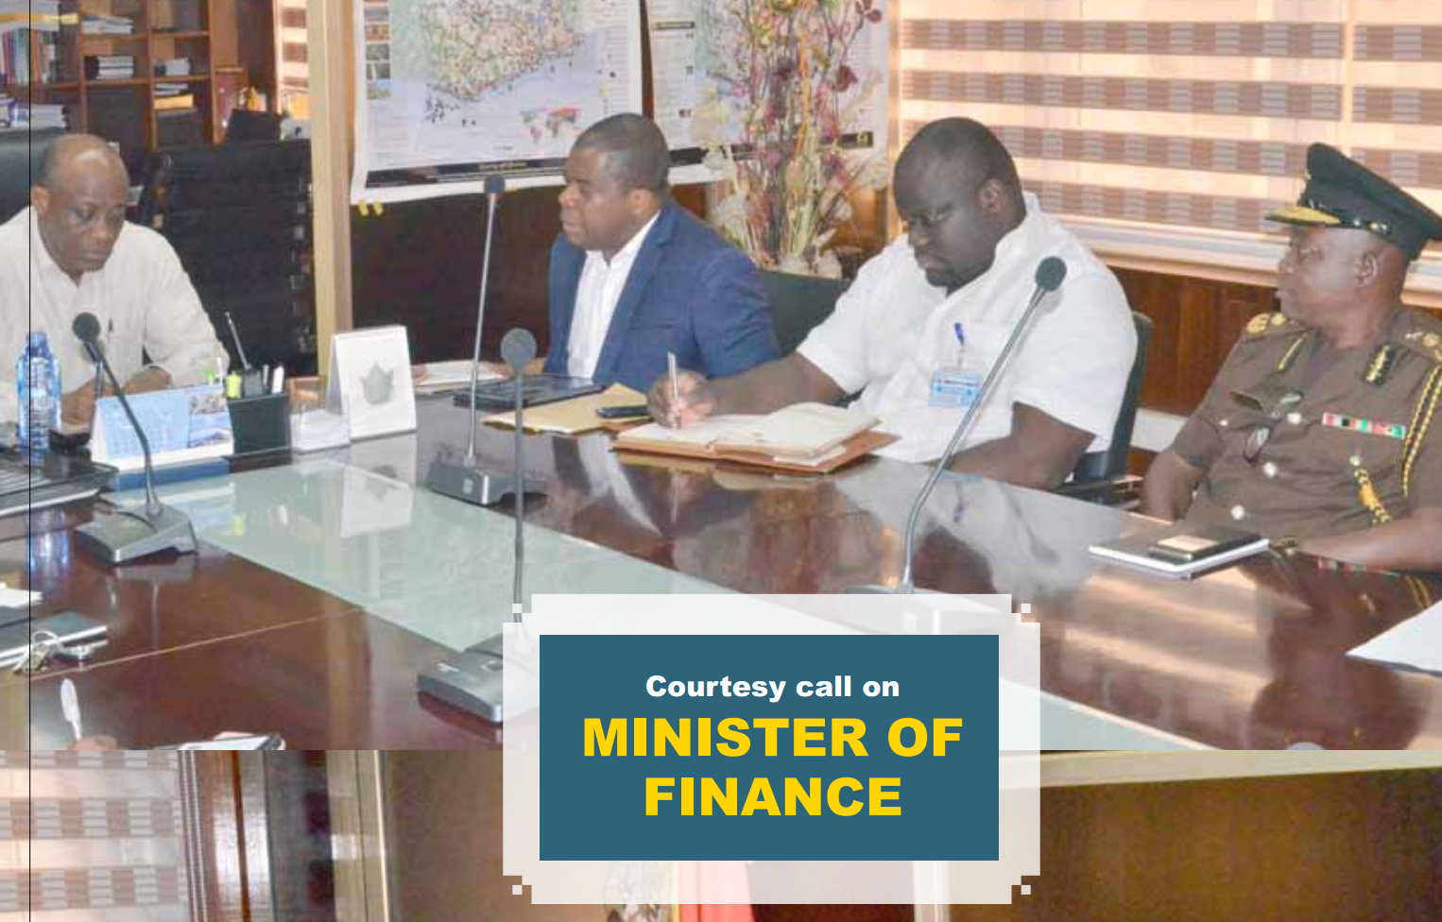

Slide 22
PUBLIC SAFETY – Prisons Policy
Ghana Prisons Council
  Revolving door
  Alternative sentencing regimes
The over congestion problem is exacerbated by the criminal justice system when persons are put on remand for eight to sixteen years (S. K. Boateng, 2015; CHRAJ, 2006; Koomson, 2015).
No sole remand prison – first underway

Slide 23
Finally political decisions and policies should be crafted scientifically using hardcore DATA not what party elders say
Policies should not be winner-takes-all centric
When in Geneva, we got better up-to-date data about the continent from Europe than from our statistical agencies

Slide 24
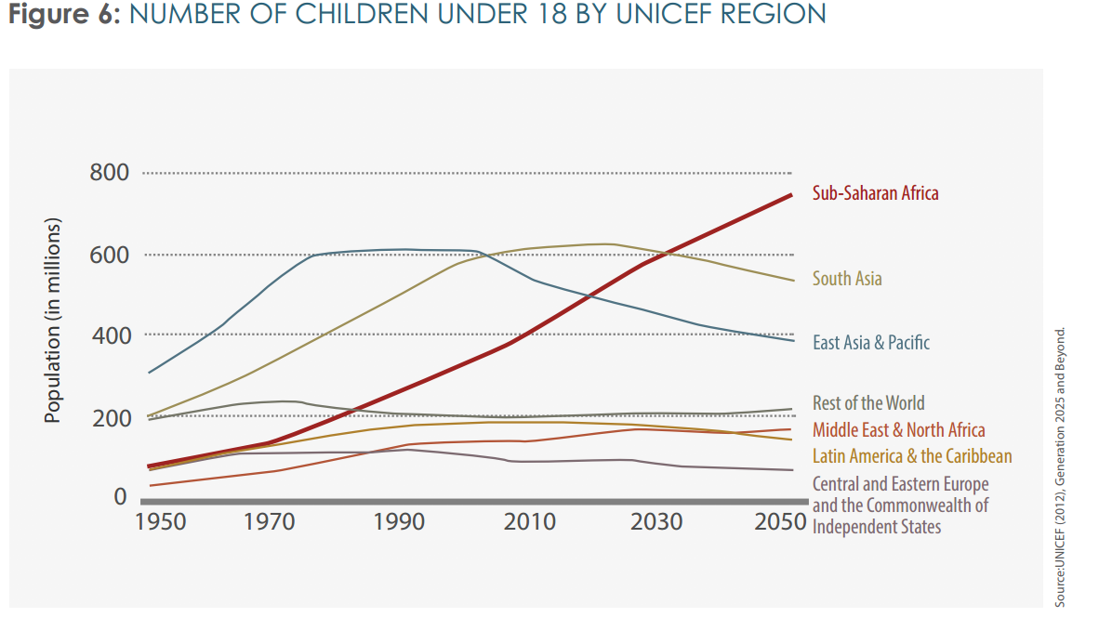
Same can be done for regions, municipalities, districts and this can inform health policy

Slide 25
TRANSPARENCY AND ACCOUNTABILITY IS KEY IN GOVERNANCE
The White House @WhiteHouse
No smoke and mirrors: "Anyone with computer access can download and read the transcript.”
This is democracy. People read and make up their minds for themselves

