Slide 1
AFRICAN REGIONAL CONFERENCE OF THE WORLD CONGRESS OF FAMILIES
PRISON FOR CHANGE, NOT CHANGE
Presented by:
DR. ABENA ASOMANING ANTWI

Slide 2
IMPRISONMENT IN AFRICA
Country | Inmate Population
Ghana | 15, 461
Nigeria | 39, 153
Togo | 3, 200
Mali | 4,040
Cote d’lvoire | 10,355
Senegal | 5,360

Slide 3
IMPRISONMENT IN GHANA
By the 1860, the Prisons Ordinance Act was developed to guide the protocols of imprisonment in Ghana
The Ghana Prison Service attempts to reform and rehabilitate the lives of inmates through various strategies
Current prison population stands at over 14,000 (instead of the designed capacity of 9,945)
Trends of indicate a stagnating trajectory - years 2010 (13,945), 2011 (13,565) and 2012 (13,469) but with a 23% rate of recidivism

Slide 4
IMPRISONMENT IN GHANA
There are 45 prison facilities in the country
There is a feeding allowance of Ghc1.80 per inmate for three meals a day
There are 7 female prisons and one juvenile prison (male)

Slide 5
THE REALITY OF INCARCERATION IN AFRICA
Imprisonment is a Western import into Africa from the colonial days
A large proportion of the prison population in African countries is comprised of remand inmates
For example, two-thirds of the 18,000 inmates in Uganda have yet to be tried. In South Africa's Johannesburg Prison, some inmates have not seen a judge in seven years
But for some white-collar crimes, there are many cases associated with poverty
Imprisonment imposes financial hardships on the entire family
Absent social support systems for ex-offenders

Slide 6
IMPACT OF IMPRISONMENT ON THE FAMILY
Intergenerational transfer of inequality and stigmatization
Imprisonment alters an individual and family’s life chances of success in a number of ways
Negative impact on the health of individuals – HIV/AIDS, tuberculosis, mental illness, non-communicable diseases (NCDs) etc.
A breakdown in the basic family structure where the lives of children are sustained promotes prostitution as a way of survival for some children of offenders, although prostitution is criminalized in some parts of Africa
The burden or strain placed on the relationships between imprisoned parents and their children is indescribable. Parents lose opportunities to support the day-to-day development of their children
Economic burden on the entire family is enormous
Confinement/imprisonment introduces different sexual orientations to inmates

Slide 7
IMPACT OF IMPRISONMENT ON THE FAMILY
The National Centre for Health Statistics’ survey indicate that boys with absent fathers showed a greater chance of having disciplinary problems at school than boys with the presence of fathers at home
The same survey also indicated that boys with absentee fathers showed persistent signs of aggression and violent tendencies
Children of incarcerated parent(s) have learning difficulties at school with a good percentage developing a phobia for schooling
Many spouses of incarcerated people end up cheating which often lead to divorces and a breakdown in the family structure

Slide 8
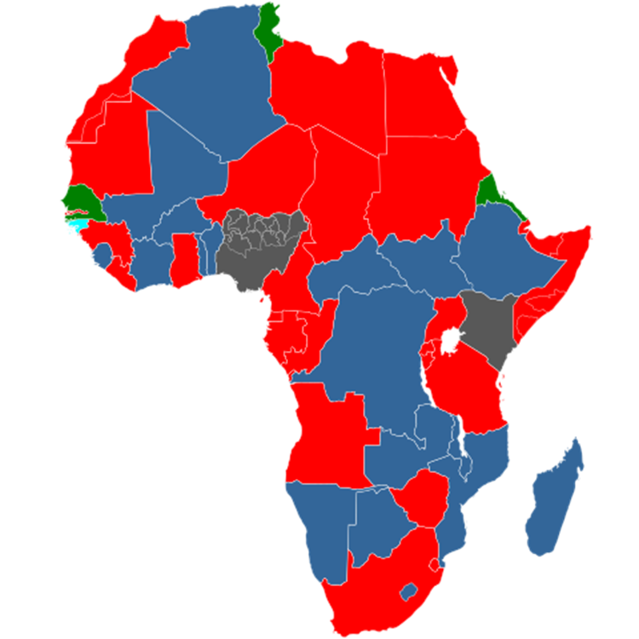
COUNTRIES IN AFRICA WHERE PROSTITUTION IS LEGAL
All red parts represent countries
which criminalize prostitution

Slide 9
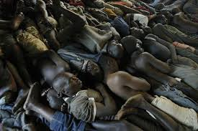
DEFICIENT LIVING CONDITIONS OF PRISONS IN AFRICA

Slide 10
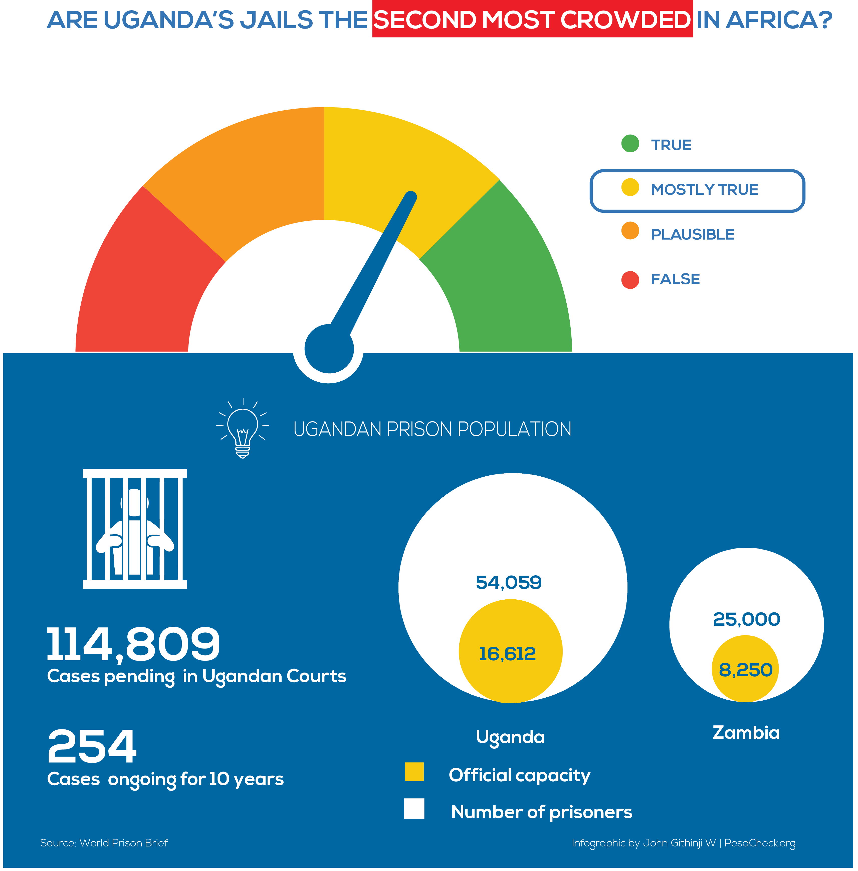
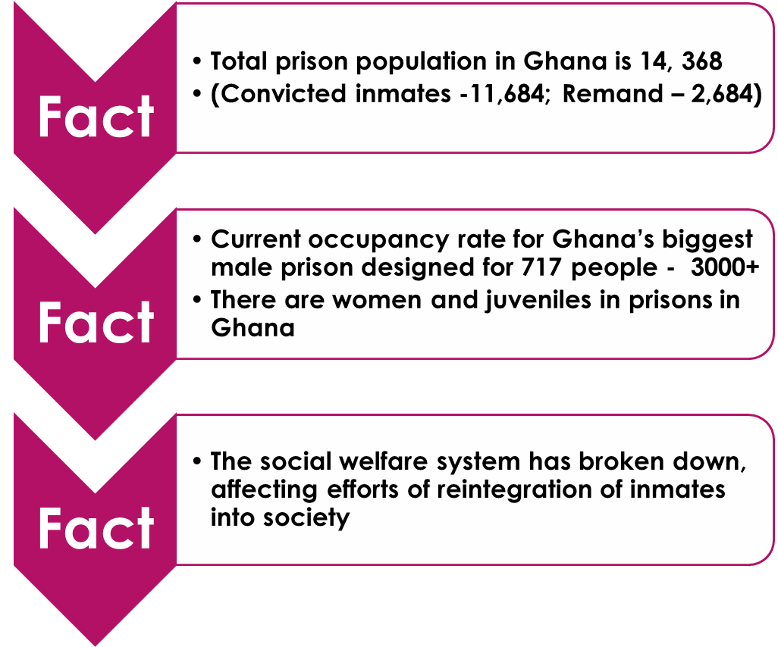
PROFILE OF PRISONS IN SELECTED COUNTRIES

Slide 11
CONNECTION OF PRISON(ERS) WITH THE SUSTAINABLE DEVELOPMENT GOALS (SDGS)
Poverty is one key determinant of crime in Africa – supposed to be addressed under the SDG 1 (End poverty in all forms)
Hunger and poor nutrition – SDG 2 (End hunger, achieve food security and improved nutrition, and promote sustainable agriculture)
Insanitary and poor living conditions in prisons – SDG 3 (Ensure healthy lives and promote well-being for all at all ages)
Rehabilitation and reformative approaches of prisons – SDG 4 (Ensure inclusive and equitable quality education and promote lifelong learning opportunities for all)

Slide 12
CONNECTION OF PRISON(ERS) WITH THE SUSTAINABLE DEVELOPMENT GOALS (SDGS)
Prison reforms for women and juveniles – SDG 5 (Achieve gender equality and empower all women and girls)
Reintegration for prisoners starts with economic empowerment – SDG 8 (Promote sustained, inclusive, and sustainable economic growth, full and productive employment, and decent work for all)
Crime-prone communities – SDG 10 (Reduce inequality within and among countries)
Environmental conditions that break up families and create refugees – SGDs 13, 14 & 15 (Environmentally-related SDGs)
The Justice administration systems in Africa – SDG 16 (Promote peaceful and inclusive societies for sustainable development, provide access to justice for all, and build effective, accountable, and inclusive institutions at all levels)
Partnerships to support efforts aimed at changing lives – SDG 17 (Strengthen the means of implementation and revitalize the global partnership for sustainable development)

Slide 13
FUTURE PROSPECTS FOR THIS SUB-ECONOMY
While there is massive support for and excitement over the African Continental Free Trade Area (AfCFTA) Agreement signed by African Union leaders on 21st of March 2018 in Kigali (Rwanda) , what are its implications on integration and subsequently on crime?
What are the safeguards proposed for immigration and policing for the member countries with 27 members of the AU signing the Protocol on Free Movement of Persons and Right to Residence?
With different ideologies regarding religion for countries, will this integration negatively affect the value system of participant countries?
With the increasing youth bulge, unemployment rates for many African countries and a high possibility of an invasion of foreign cultures, does this imply that a time is coming when there will be a trade-off between economic development and weak and often unacceptable immoral cultures among participant countries?
What are the family dynamics going to look like in terms of stability – will there not be intermarriages among the 44 countries that signed the AfCFTA?

Slide 14
What is the cost implication of the actions of criminals on the continent?
Can the punitive approaches used via the prison system serve as deterrent enough to people who may consider such progress made by the African economic block such as the proposed common currency, the AfCFTA and others, as gold mines?
In solidarity with the Christian ideals practiced and being propagated, should we not have a common voice that articulates the fundamental principles of the Bible and also, the need to protect the institution of marriage, family and of development that would remain sustainable?
A priority for the future and the sustainability of the family relies on seeking meaningful partnerships and forging ahead with a common goal

Slide 15
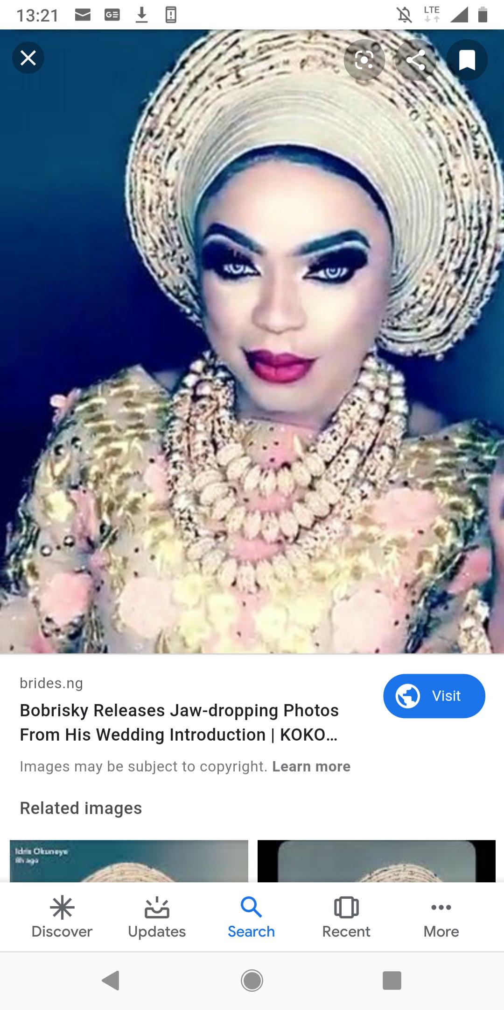
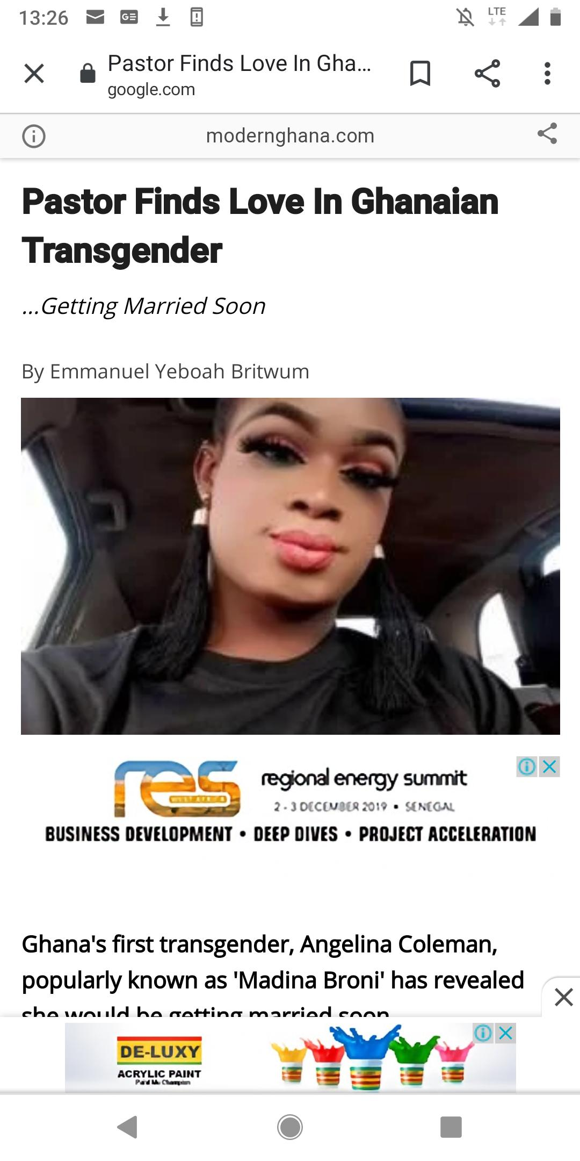
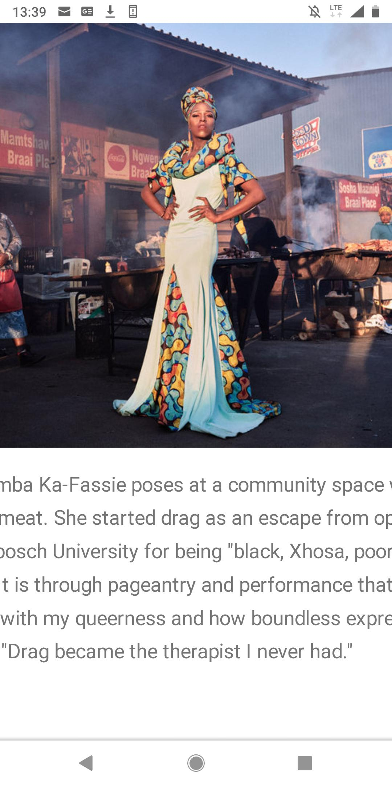
Potential for cross-cultural threats
Zambian immigrant in S.A
Nigeria
Ghana

Slide 16
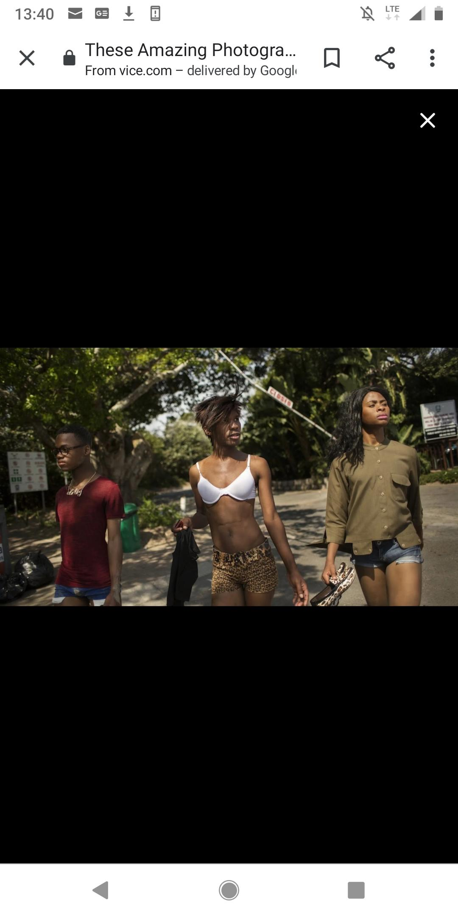
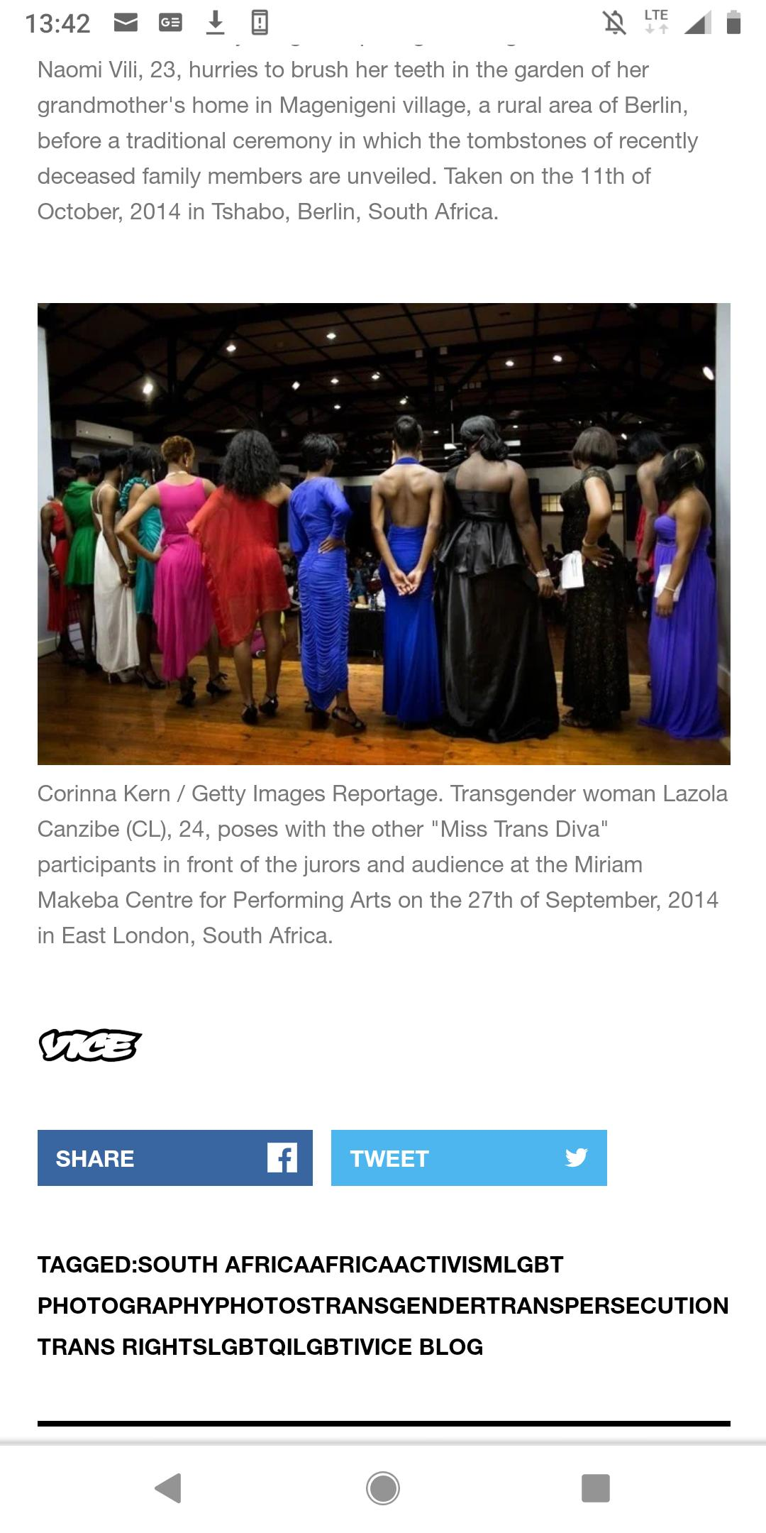
MORE EXHIBITS OF CROSS-CULTURAL THREATS
Queer beauty
Pageant in South
Africa

Slide 17
THANK YOU!

